Slide 1
Set up Golang Environment on Windows
Date of completing this PPT file: 2020/3/8

Slide 2
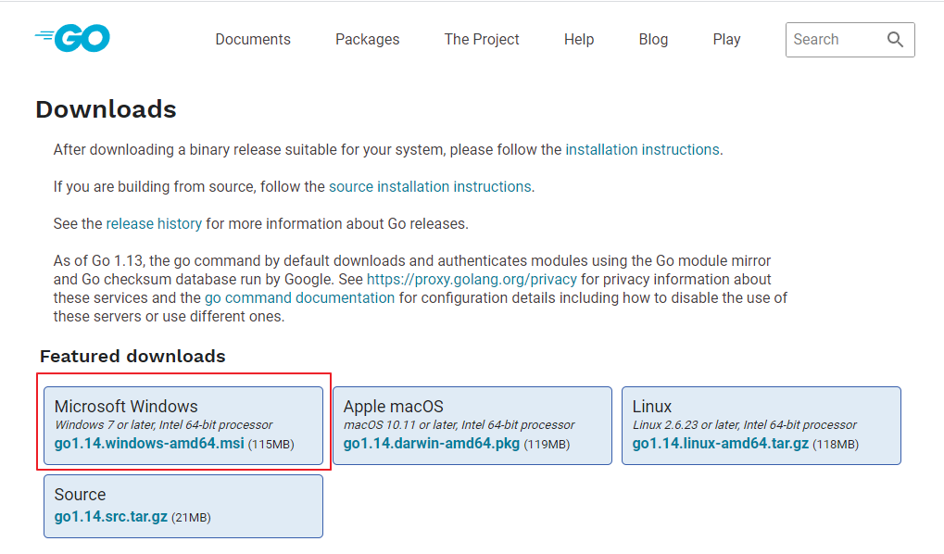
Download Golang and Install it
https://golang.org/dl/

Slide 3
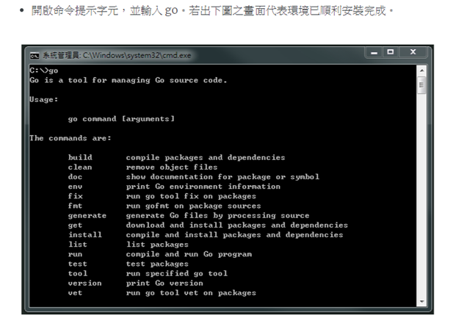
Check Go installation result

Slide 4
What did Golang installation file do?
Install Golang on Windows
Set up some environment variables:
Add new current user environment variable %GOPATH% and set it’s value as %USERPROFILE%\go, you can open “cmd” and type ECHO %GOPATH% to check it’s setting.
Set your current user environment variable %Path% append %USERPROFILE%\go\bin, you can open “cmd” and type ECHO %Path% to check it’s setting.

Slide 5
Install Golang related packages
You must download and install Git first
https://git-scm.com/
After install Git, you must open “cmd” as Administrator and run following scripts
SETX -M GOROOT C:\Go\
go get -u -v github.com/nsf/gocode
go get -u -v github.com/rogpeppe/godef
go get -u -v github.com/golang/lint/golint
go get -u -v github.com/lukehoban/go-find-references
go get -u -v sourcegraph.com/sqs/goreturns
go get -u -v golang.org/x/tools/cmd/gorename
go get -u -v github.com/derekparker/delve/cmd/dlv

Slide 6
Set up Go development environment

Slide 7
Download and Install VS Code
https://code.visualstudio.com/

Slide 8
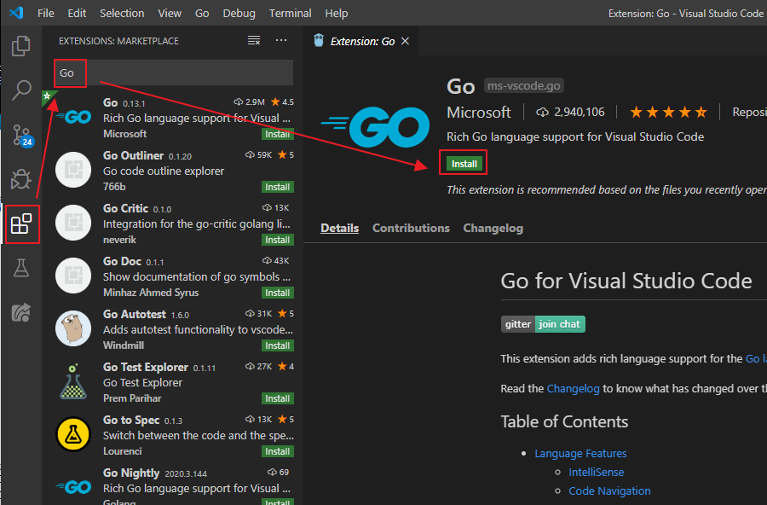
Install Go extension package on VS Code

Slide 9
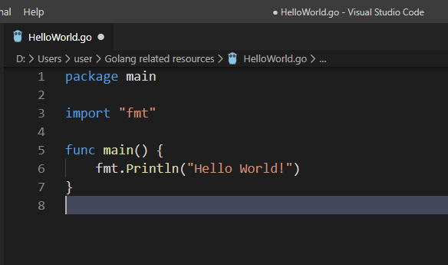
Your first “Go” program
Create new file and name it as HelloWorld.go
Copy following code to your VS Code
package main
import "fmt"
func main() {
fmt.Println("Hello World!")
}

Slide 10
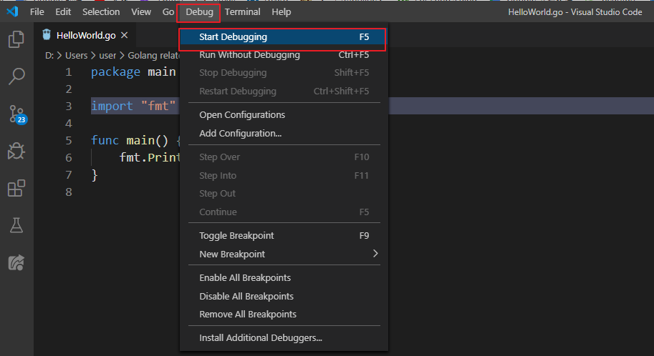
Run and Debug

Slide 11
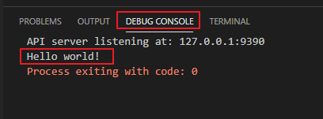
Output result

Slide 12
Reference
https://oranwind.org/go-ide-visual-studio-code/

